Slide 1
Diabetes
Leading contributing Factors
Lesley Conn, Katrina Brown, Triston Cavaness and Juliet Hamilton

Slide 2
Diabetes Onset and Diagnosis Review
Data used
Kaggle data that contained 100,000 rows
CDC information provided 2018 research on diabetes and obseity for more than 3,141 counties in the United States
Areas analyzed
Male and female populations
Age
Body Mass Index (BMI)
Smoking history
Hypertension
Fasting and non-fasting blood glucose levels
Heart disease
Limitation
Neither source included patient race and/or ethnicity, though some hypotheses were developed after mapping the CDC data based on county codes, then referencing locations against U.S. Census data for those counties.

Slide 3
United States Diabetes Facts
Total: 38.4 million people have diabetes (11.6% of the US population)
Diagnosed: 29.7 million people, including 29.4 million adults
Undiagnosed: 8.7 million people (22.8% of adults are undiagnosed)
Prediabetes
Total: 97.6 million people aged 18 years or older have prediabetes (38.0% of the adult US population)
65 years or older: 27.2 million people aged 65 years or older (48.8%) have prediabetes

Slide 4
Risk Factors for Diabetes-Related Complications
Smoking
Overweight and Obesity
Physical Inactivity
A1C
High Blood Pressure
High Cholesterol

Slide 5
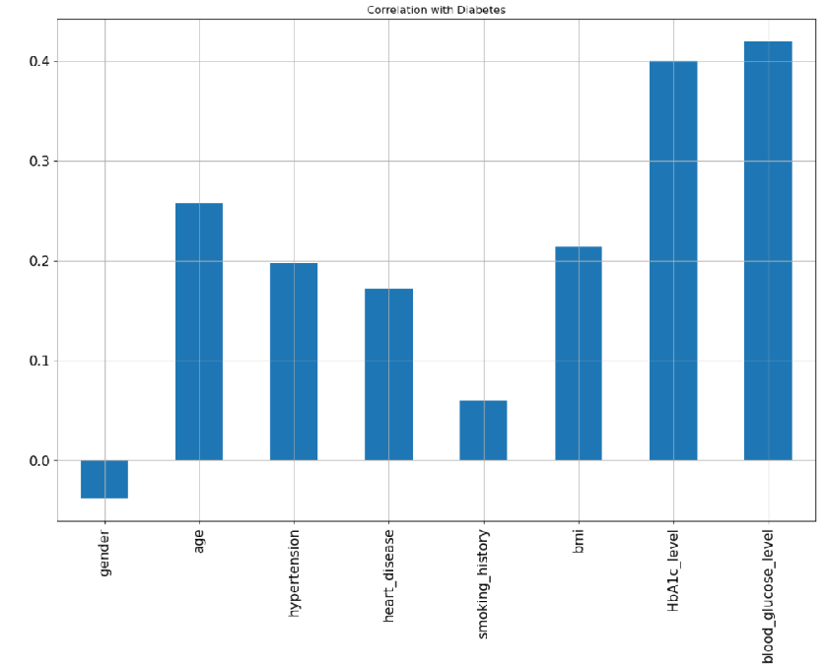
Correlation with Diabetes
The Kaggle data examined gender, age, hypertension, heart disease, smoking history, BMI, HBA1C levels, and glucose levels.

Slide 6
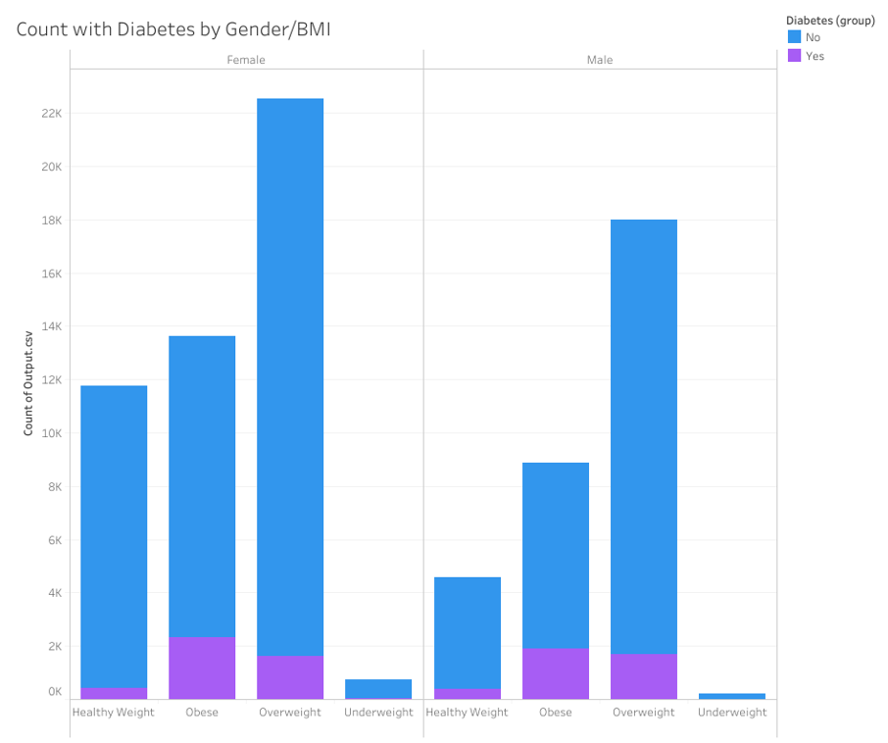
Analysis of Diabetics and Weight Levels
Women have higher levels of obese and overweight patients.
This analysis drove us to look at details in both men and women and also combined group.

Slide 7
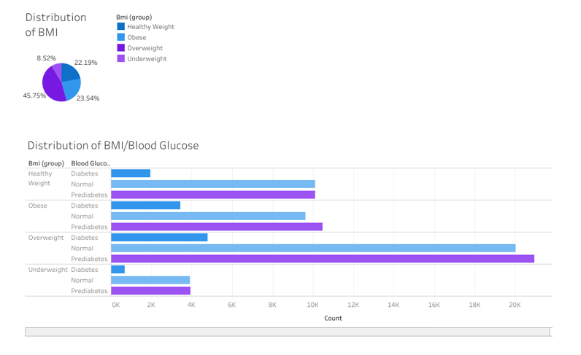
Distribution of Key Measurements
Distribution of BMI
23.5% are Obese
45.75% are overweight
Distribution of BMI/Blood Glucose
Overweight group has largest group with 4.7k (10% of group)
Obese group has 3.5k people(15% of group)
Obese group has higher percentage of people that are Diabetic

Slide 8
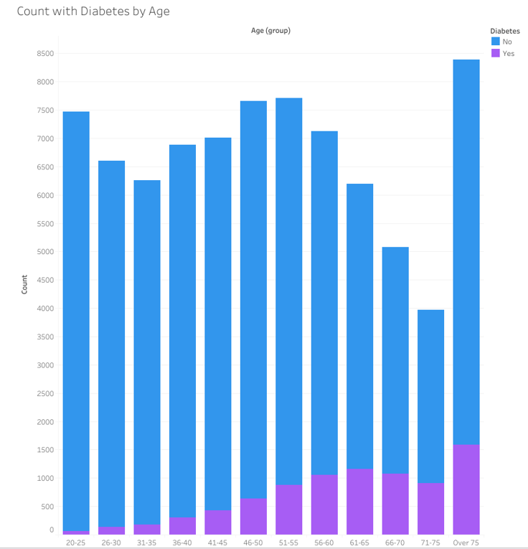
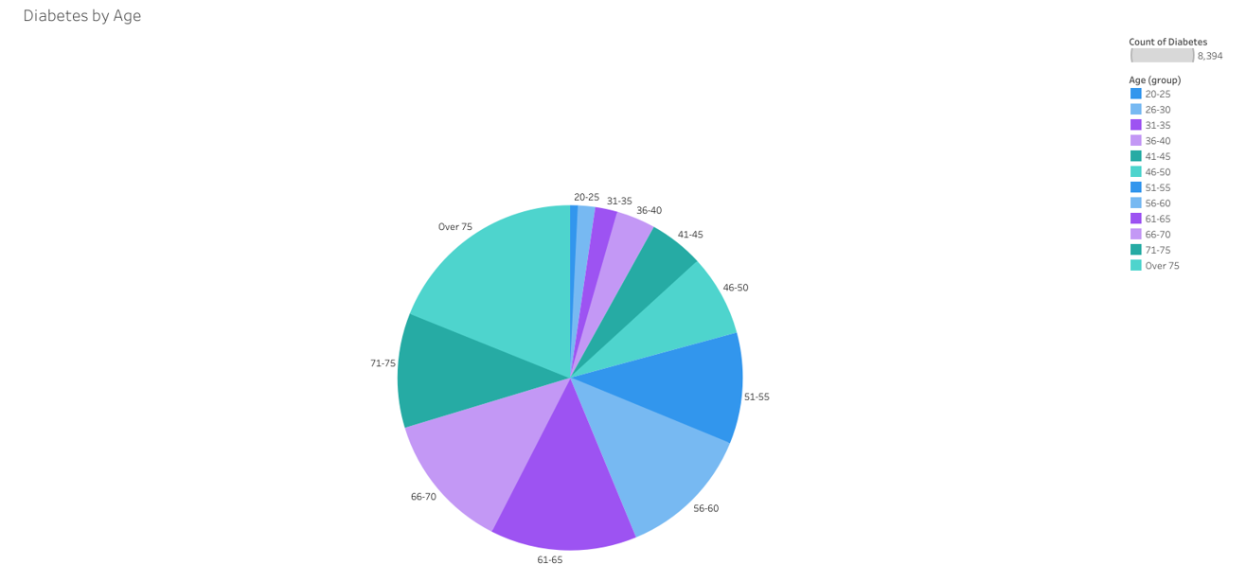
Analysis Age Distribution of patients with Diabetes
Diabetes increases with age. Key age point based on data begins at age 50.
79.2% of Diabetic group comes from ages 51 and older
Over 75 years is largest group with 18.9% of total group.

Slide 9
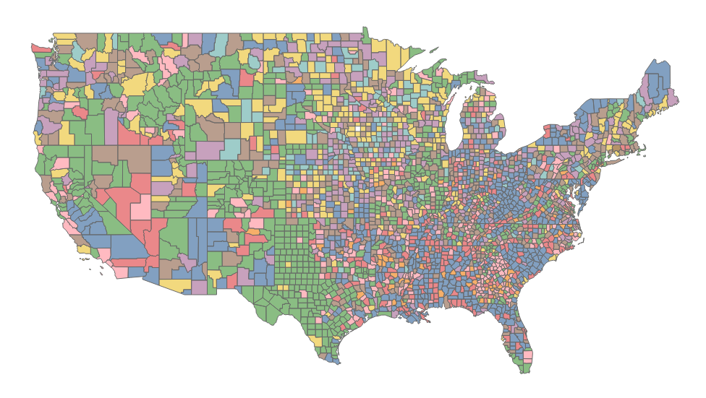
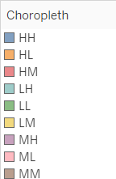
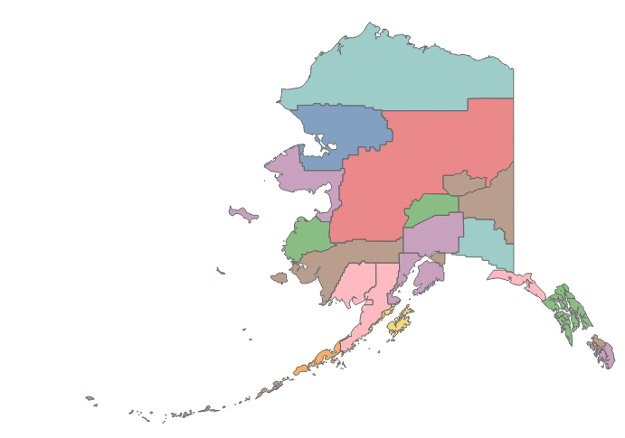

Bivariate Choropleth for Diagnosed Diabetes and Obesity (2018)

Slide 10
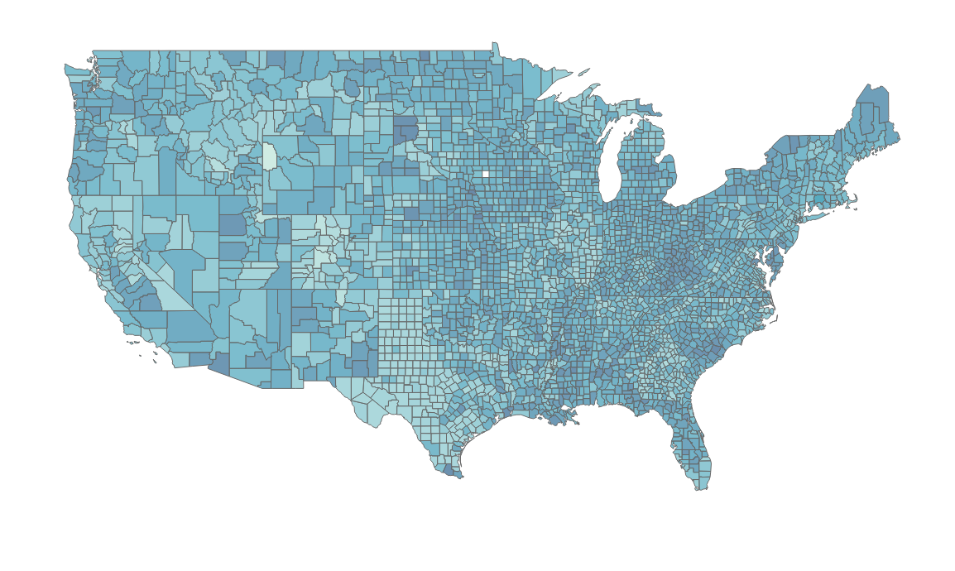
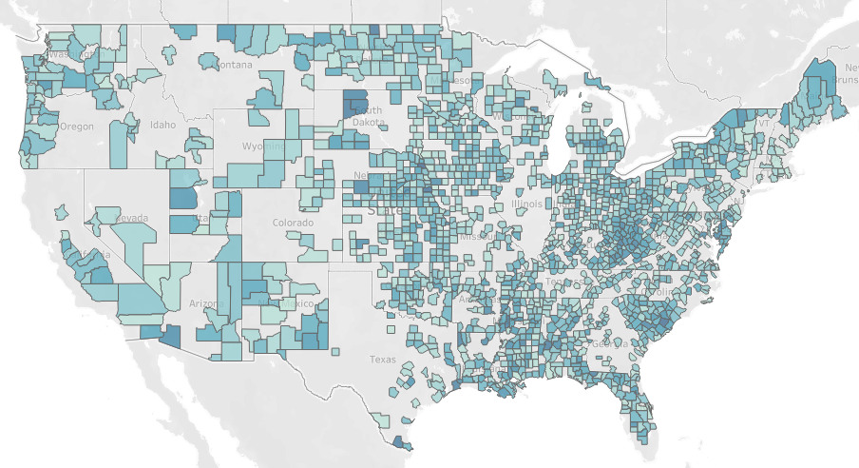
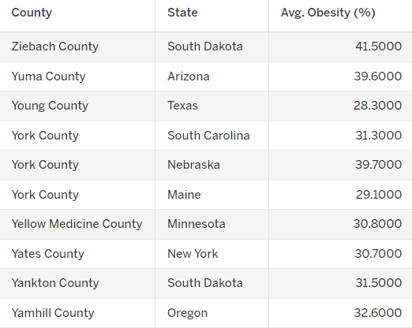
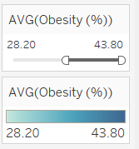
Obesity Map by County Results

Slide 11
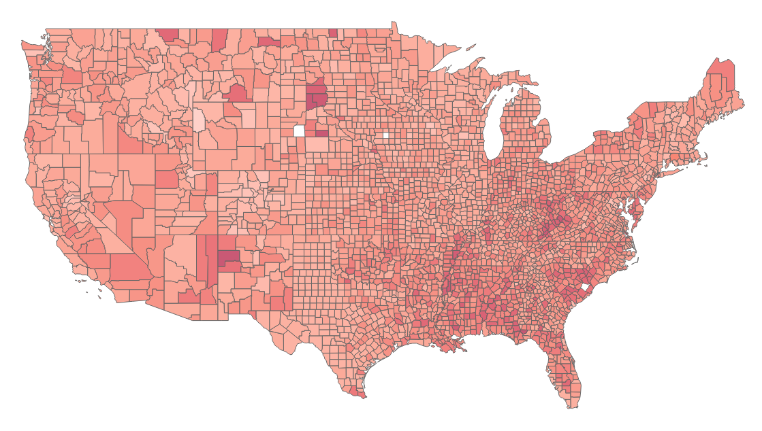
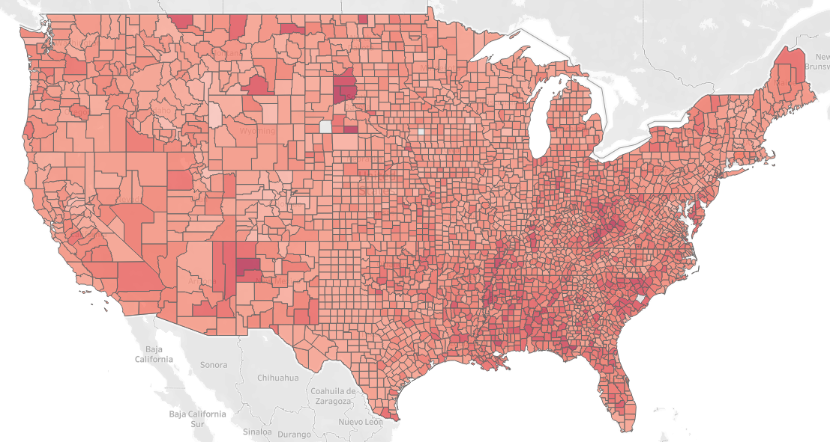
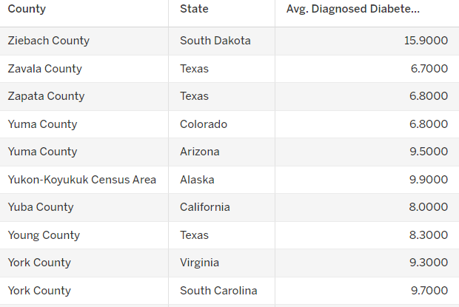
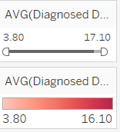
Obesity Map by County Results

Slide 12
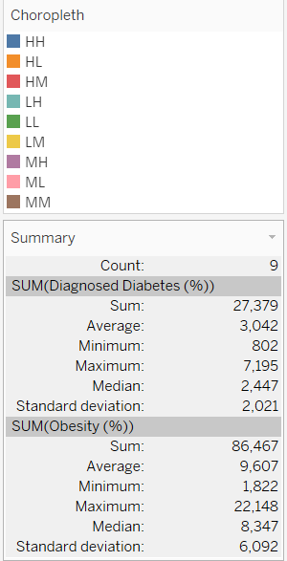
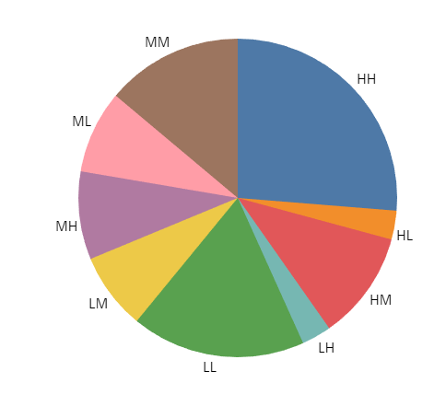
Choropleth for Diagnosed Diabetes
This analysis is based on Obesity and Diabetic results
HH represents the largest percentage with 7.2% Diabetic and 22.2% Obese
LL represents the second largest grouping with 4.8% Diabetic and 14.2% Obese

Slide 13
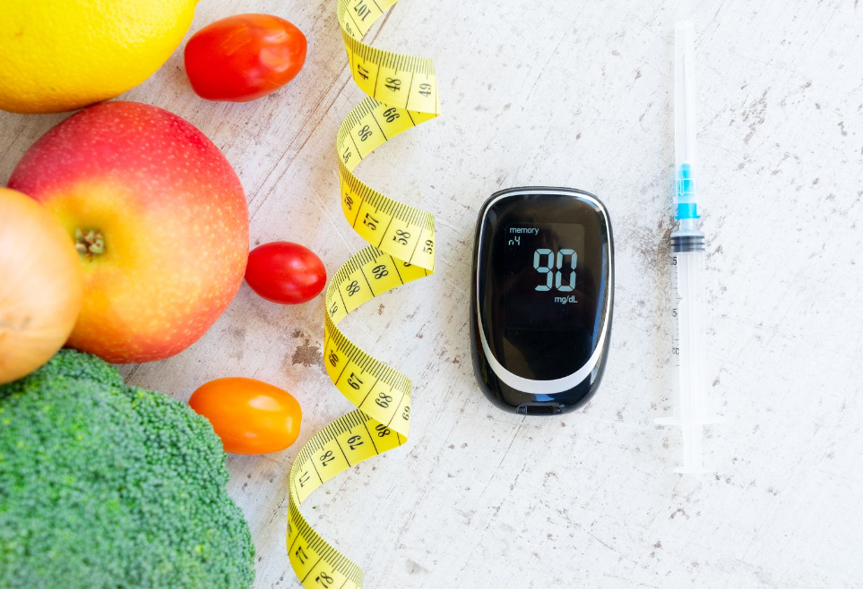
Preventing Diabetes-Related Complications
Usual Source for Diabetes Care
Physical Activity
Weight Management
Statin Treatment
A1C, Blood Pressure, Cholesterol, and Smoking (ABCs)

Slide 14
Questions

